Slide 1

Spring Boot

Slide 2
Spring Boot
Spring was lightweight in terms of component code, but heavyweight in terms of configuration
Spring 3.0 introduced a Java-based configuration as a type-safe and refactorable option to XML.

Slide 3
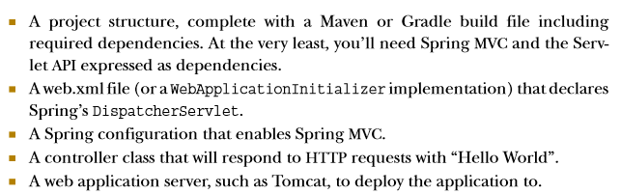
Simple Example
Developing a very simple Hello World web application with Spring requires:

Slide 4
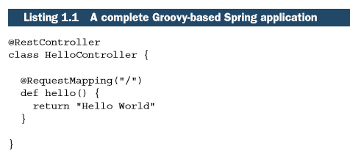

Simple Example in Spring Boot

Slide 5
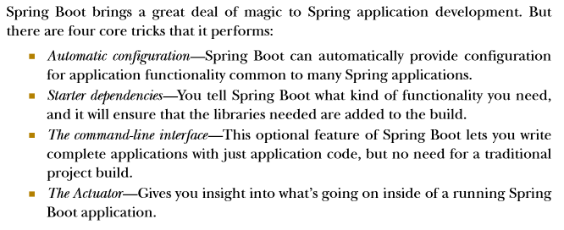
Examining Spring Boot essentials

Slide 6
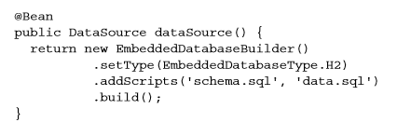

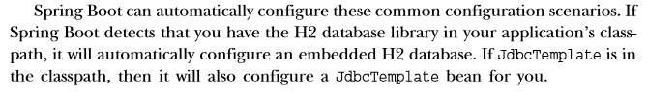
Auto configuration
Example java configuration in a Spring application:

Slide 7
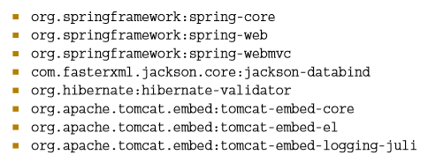

Starter dependencies
Example: for building a REST API with Spring MVC that works with JSON resource representations, you´ll need at least the following eight dependencies in your Maven or Gradle build:

Slide 8
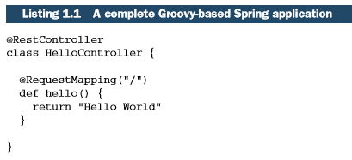
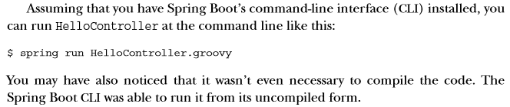
The command-line interface (CLI)
Although it provides tremendous power and simplicity for Spring development, it also introduces a rather unconventional development model.

Slide 9
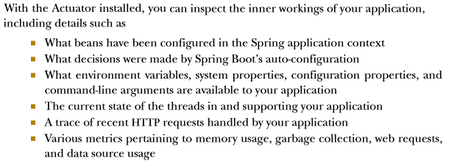
The actuator

Slide 10
Spring Initializr
Is used to create the Spring Boot project structure
Spring Initializr can be used in several ways:
Through a web-based interface
Via Spring Tool Suite
Via IntelliJ IDEA
Using the Spring Boot CLI

Slide 11
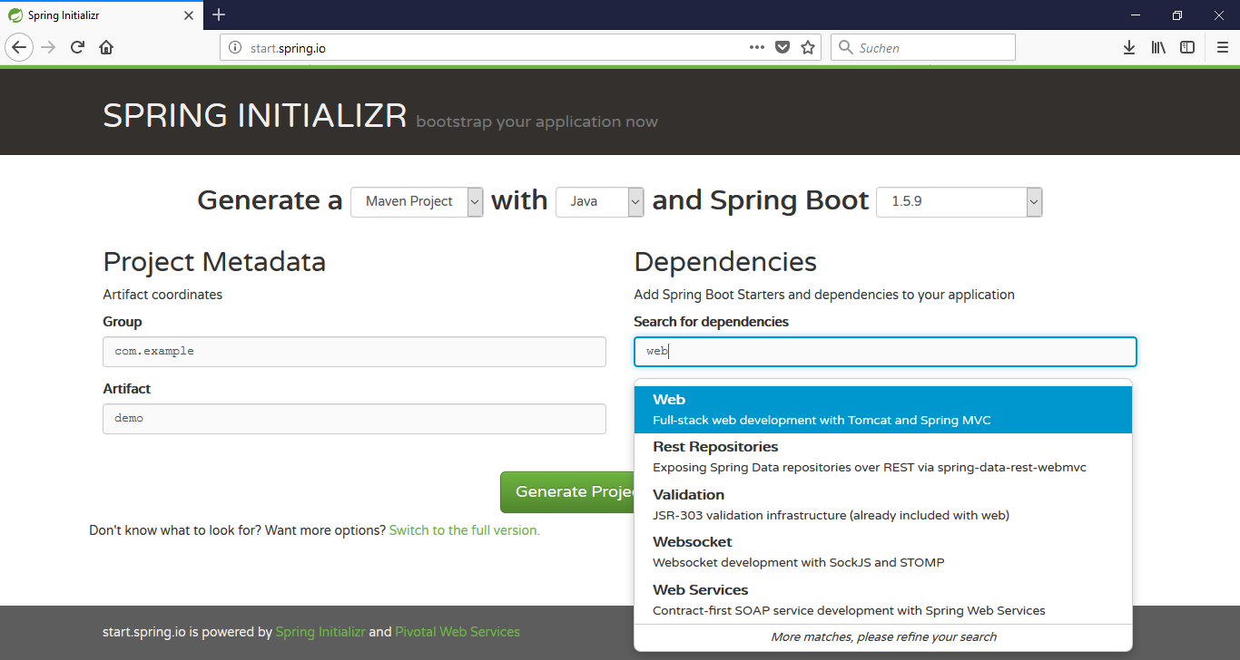
Using spring Initializr’s web interface
or Gradle

Slide 12
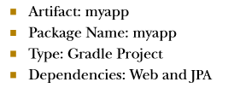
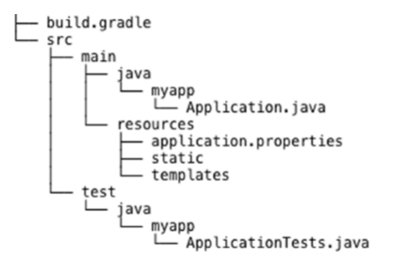
Using spring Initializr’s web interface
For example, suppose that you were to specify the following to Spring Initializr:
The downloaded project structure would look like the following:

Slide 13
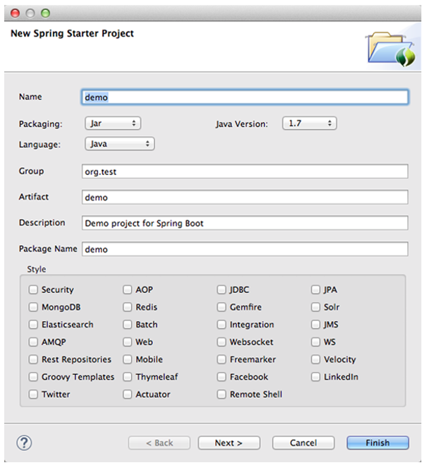
Creating Spring Boot projects in spring tool suite

Slide 14
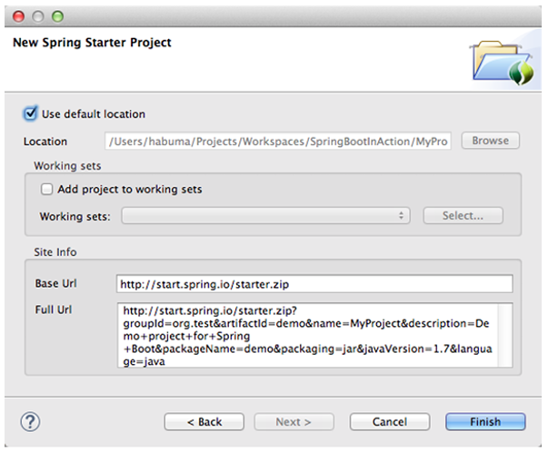
Creating Spring Boot projects in Spring tool suite
Spring Tool Suite integrates with Spring Initializr to create and directly import Spring Boot projects into the IDE.

Slide 15
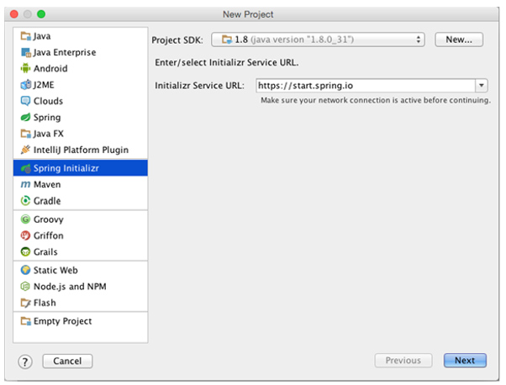
Creating spring boot projects in IntelliJ idea
Same here

Slide 16
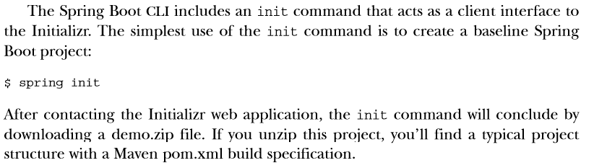
Using the Initializr from the Spring Boot CLI

Slide 17
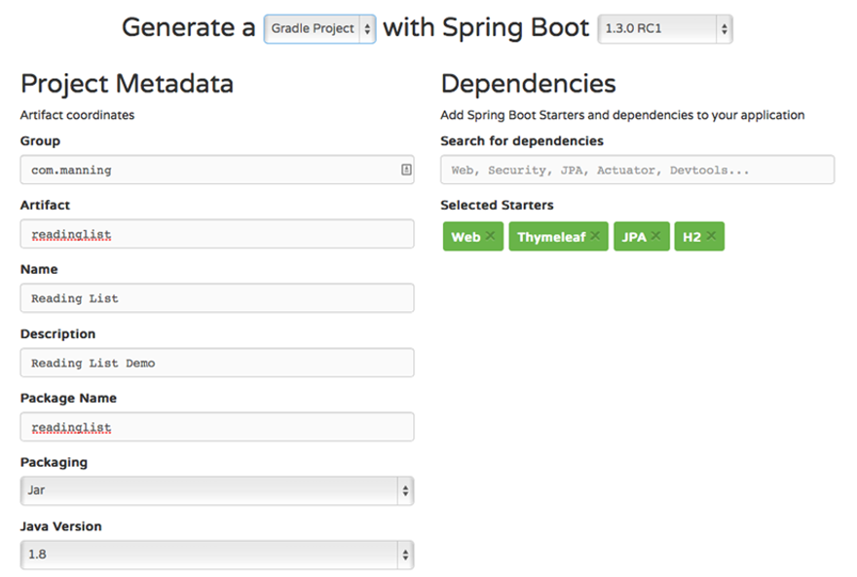
Putting Spring Boot to work

Slide 18
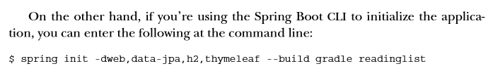
Putting Spring Boot to work

Slide 19
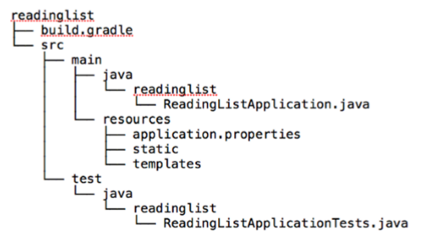
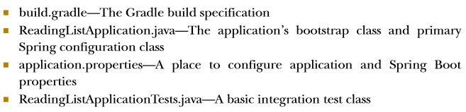
Putting Spring Boot to work

Slide 20
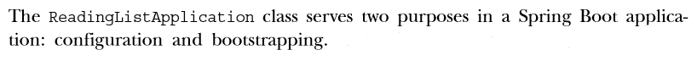
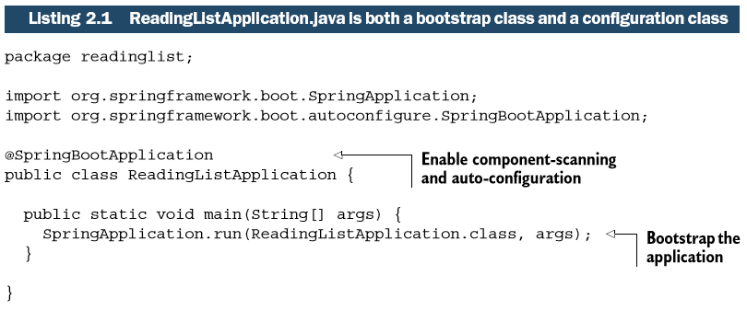
Bootstrapping Spring

Slide 21
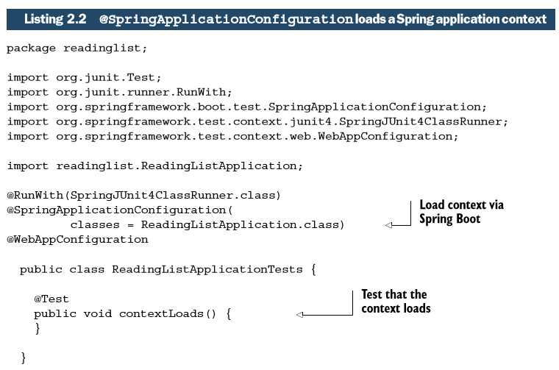
Testing Spring Boot applications

Slide 22
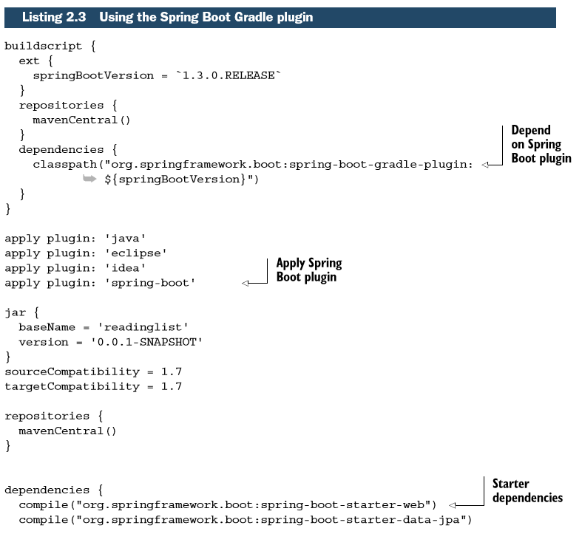
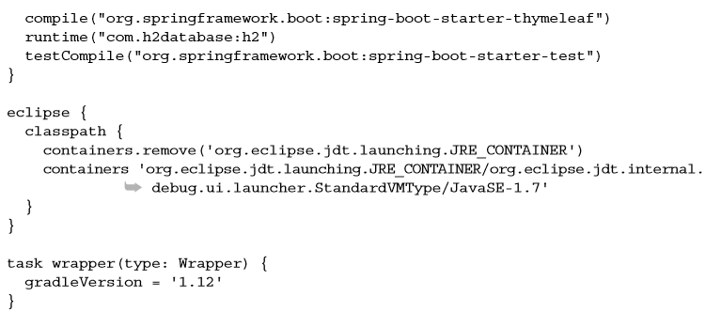
Dissecting a Spring Boot project build
Using Gradle plugin

Slide 23
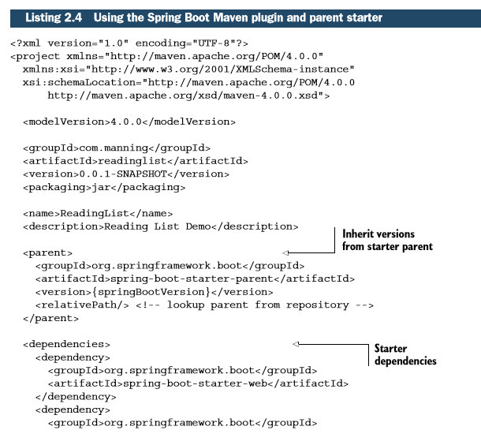
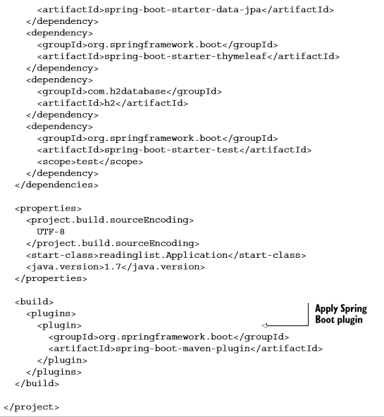
Dissecting a Spring Boot project build
Using Maven plugin

Slide 24
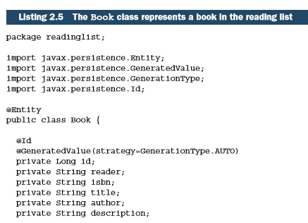
First project
Define an entity class that represents a book:
→ Also create Getters and Setters

Slide 25
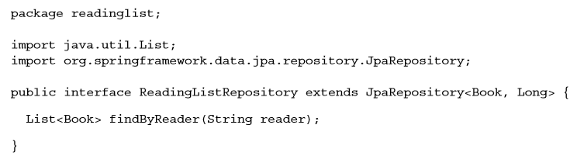
Defining the repository interface
Spring Data provides a special magic of its own, making it possible to define a repository with just an interface. The interface will be implemented automatically at runtime when the application is started.

Slide 26
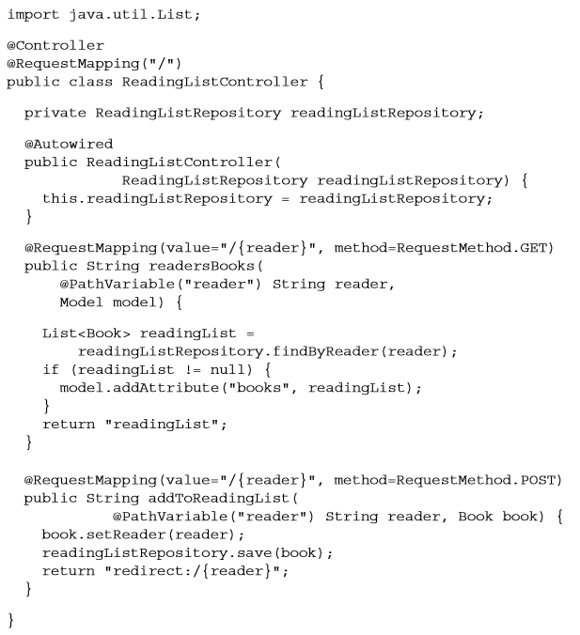
Creating the web interface

Slide 27
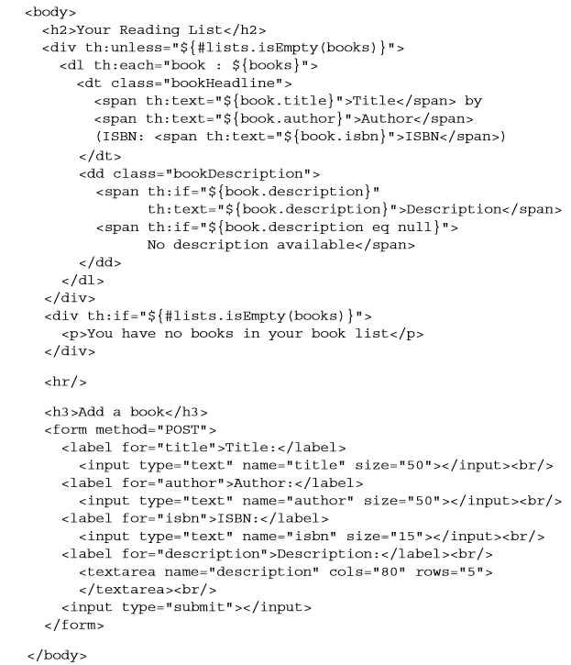
Creating the web interface

Slide 28
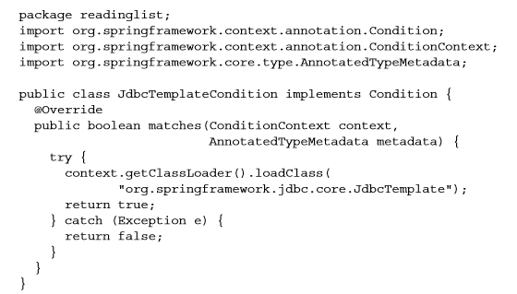
Write your own conditions in Spring

Slide 29
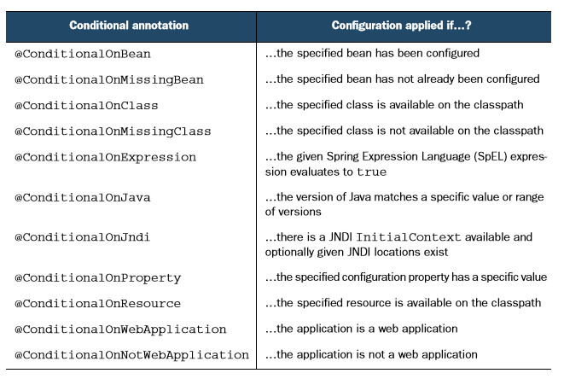
Conditional annotations used in auto-configuration

